Slide 1
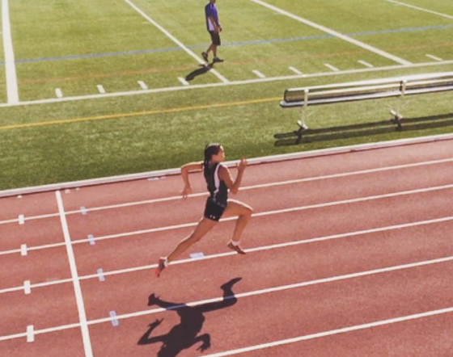
Run With It
Ron Dorland @rondorland

Slide 2
Picture from https://www.pinterest.com/pin/232779874460202251/

Slide 3
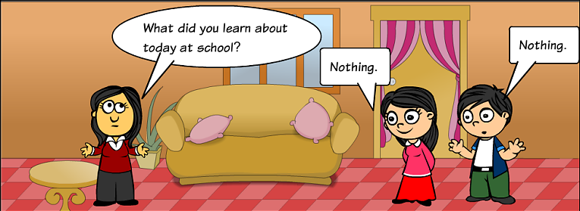
Picture from https://mrsgoogle1.wordpress.com/page/2/

Slide 4
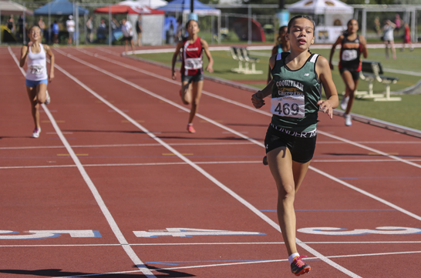
Picture from the Kamloops Times

Slide 6
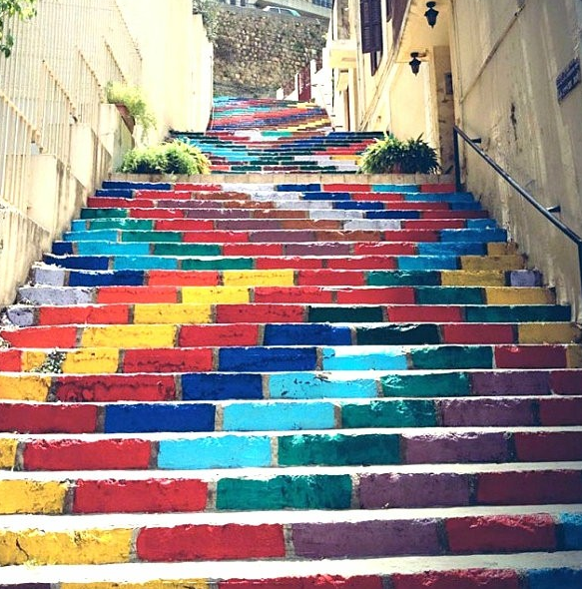
Photo from decoratingroomideas.com

Slide 7
Photo by antiochcriticalskills.wordpress.com

Slide 8
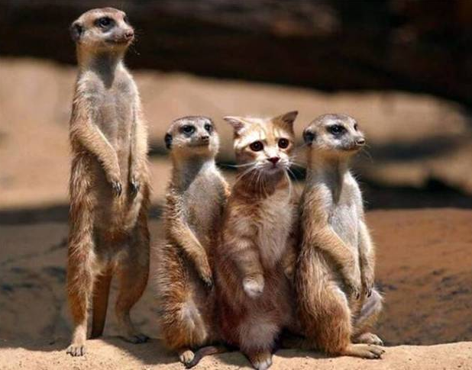
Photo by financialadvisercoach.com

Slide 9
Photo from flickr.com

Slide 10
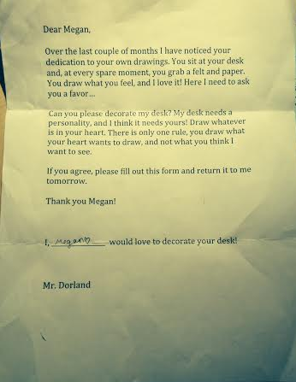

Slide 11
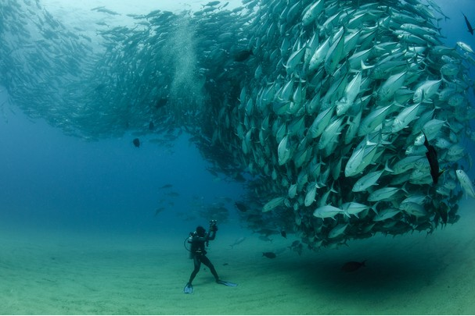
Photo from cdn.osxdaily.com

Slide 13
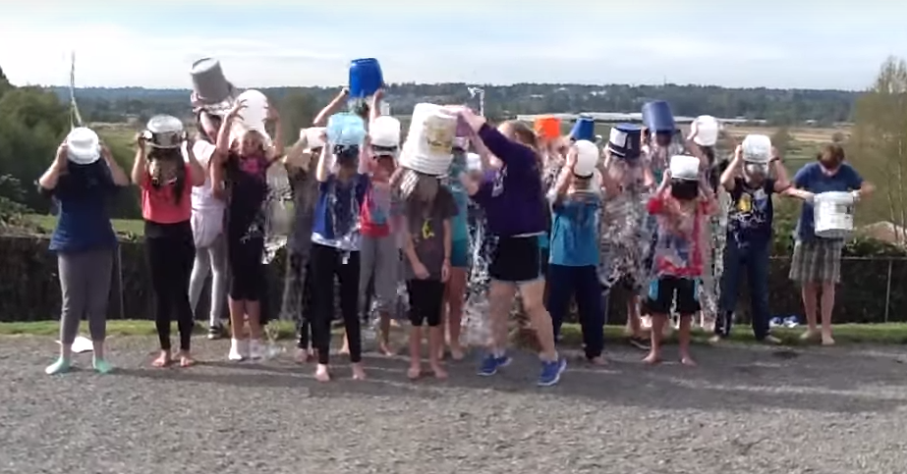

Slide 14
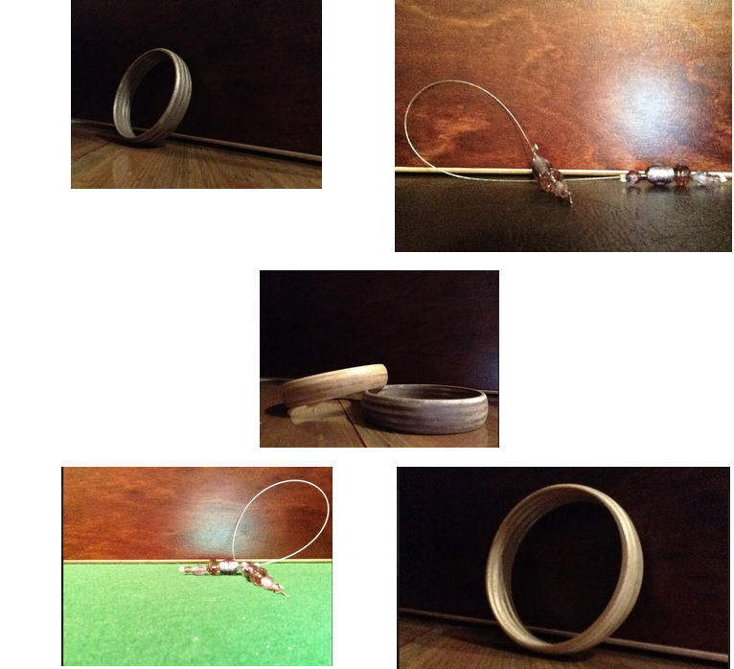

Slide 15
Photo from playbuzz.com

Slide 16
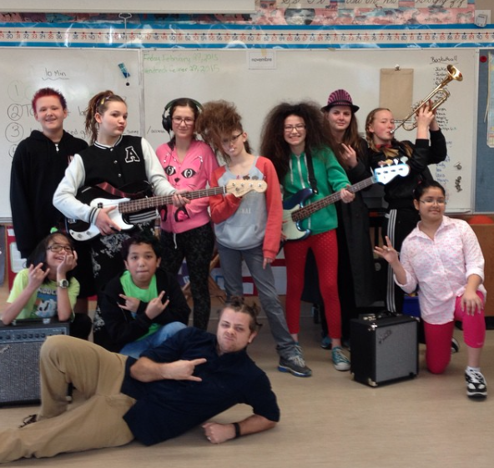

Slide 17
Photo from webdesignerdepot.com

Slide 18
Photo by inc.com

Slide 20
Photo by moshlabs.com

