Slide 1
Ron Dorland
@rondorland
http://wallpaper-kid.com/superman-wallpaper.htm

Slide 2
http://www.eyeonwindows.com

Slide 3
http://hdw.eweb4.com/search/florida/
Our Sandbox

Slide 4
http://www.ignite.org.uk/

Slide 5
http://myweb.usf.edu/~aheindel/PBSsection2.html

Slide 6
The routine answer to the common every day question!
http://imgarcade.com/1/what-did-you-learn-in-school-today/

Slide 7
Unknown.

Slide 8
http://cybraryman.com/chats.html

Slide 9
http://shinodaarts.deviantart.com/art/your-heart-in-a-book-153789289

Slide 10
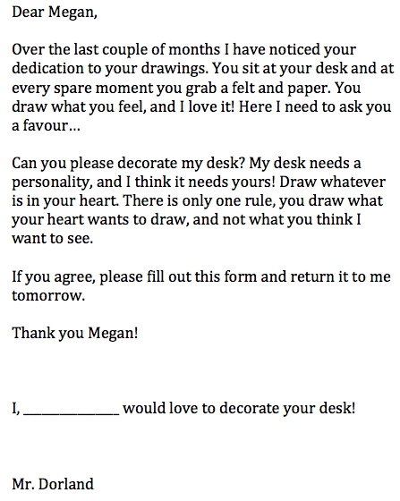
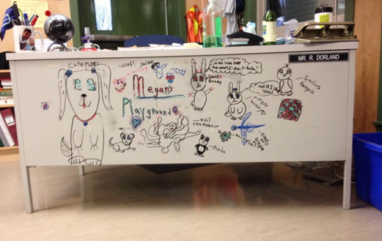
Mark on her last math quiz, EXCEEDING!
Meet Megan!

Slide 11
The Mind Will Always Follow The Heart
http://www.bewellassociates.com/2014/02/the-heart-mind-stress-connection/

Slide 12
http://www.doityourself.com/

Slide 13
Address Global Issues
http://www.sanccob.co.za/

Slide 14
http://www.allianceabroad.com/winter-coming/christmas-in-australia-4/
Christmas in Australia

Slide 15
http://www.midilifestyle.com/blog/basic-controller-build/

Slide 16
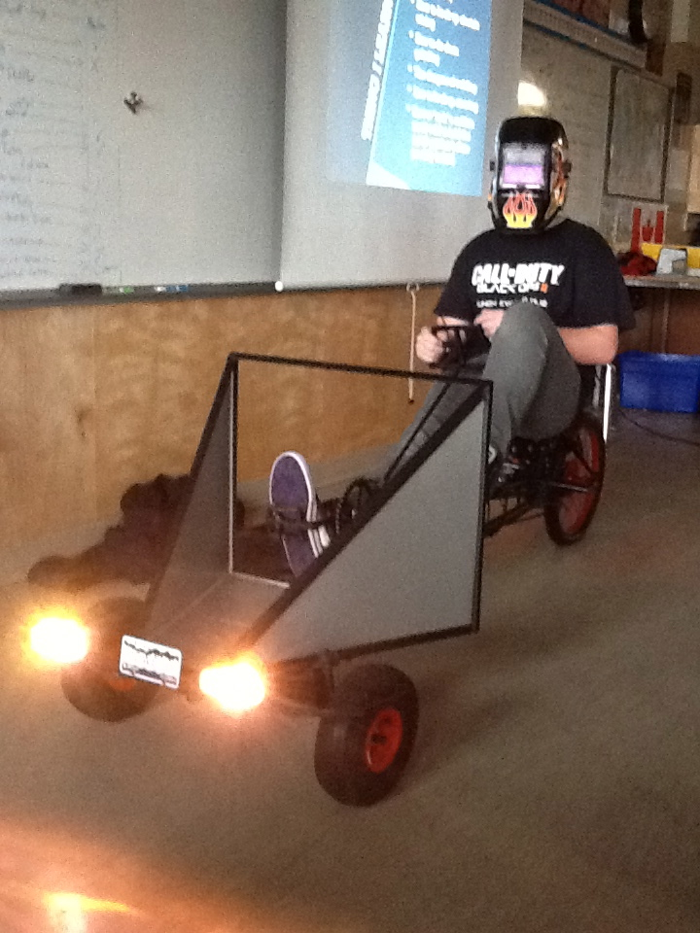
Passion
Creativity
Fun
Engagement
Hands-on

Slide 18
http://www.thatsreallypossible.com/wp-content/uploads/2014/04/hands_holding_future_sig_450.jpg

Slide 19
http://warriorfitness.org/wp-content/uploads/2013/09/innovation_stagnation.jpg

